Slide 1
Linting with agentic AI
Llewellyn Falco

Slide 2
124 lint errors detected

Slide 3


concept
Script Deterministic
Focus AI

Slide 4
START
Run Tests
EXIT
FAIL
PASS
Run Linter | lint-results.txt
Read lint.process.md
Read
.temp/lint-results.txt
Select 1
random issue
Lint Issues?
Run Tests
Commit Changes
YES
PASS
Play
Chime
Apply code fix
Generate
commit message
commit-message.txt
NO
FAIL
ALL DONE
Revert Changes
CLAUDE
Repeat
PYTHON

Slide 5
linting.process.md
Read the .temp/lint-results.txt file and choose a random issue, and fix that one issue.
Write a git commit message that describes the changes you made to .temp/commit-message.txt.
Here's an example of what the commit message should look like:
fix(lint): Fixed Issue ST1005 <short_issue_description>
NEVER turn off linting. Only fix the code to use a better pattern the linter is pointing out.
NEVER use voice unless something goes wrong.
If you do not know a better pattern, first, google it, and if that doesn't work, then instead of fixing it, tell me "I don't know how to fix this"

Slide 6
START
Run Tests
EXIT
FAIL
PASS
Run Linter | lint-results.txt
Read lint.process.md
Read
.temp/lint-results.txt
Select 1
random issue
Lint Issues?
Run Tests
Commit Changes
YES
PASS
Play
Chime
Apply code fix
Generate
commit message
commit-message.txt
NO
FAIL
ALL DONE
Revert Changes
CLAUDE
Repeat
PYTHON

Slide 7
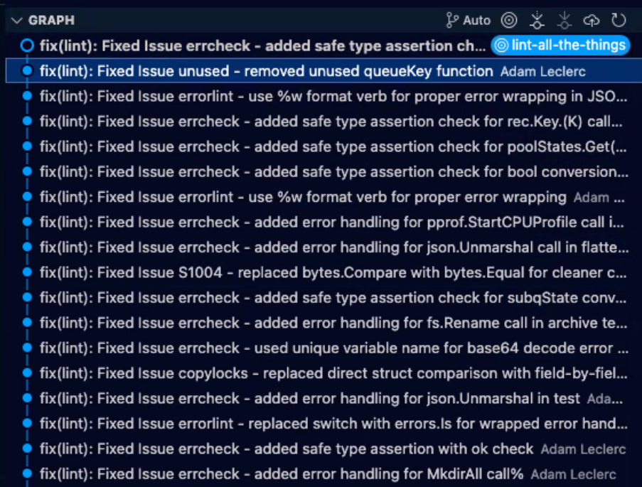

Slide 8
delinter.md
Delinter
This is a python script that reads the .temp/lint-results.txt file and fixes the first issue. All temporary files are stored in the .temp directory which is ignored by git.
Steps
Run Tests, Ensure they pass
Linting (saves results to .temp/lint-results.txt)
Claude Fixes Linting (writes commit message to .temp/commit-message.txt)
Run Tests, Ensure they pass. If they do, commit the changes and play a chime. Otherwise, revert. Repeat up to 1000x by default.
Running Tests
mise test
Linting
mise lint1 | tee .temp/lint-results.txt
Fixing
Call claude code on the cli and pass it the prompt lint.process.md file. Have it exit afterwars and use dangerously-skip-permissions to skip the permissions check.
Committing
git add .
git commit -F .temp/commit-message.txt
Chime
After each successful iteration (commit), the script plays a system chime sound (Glass.aiff on macOS) to notify that the iteration is complete. delinter.md Displaying delinter.md.
1

